Slide 1
An Introduction to Chemistry
Chapter 1

Slide 2
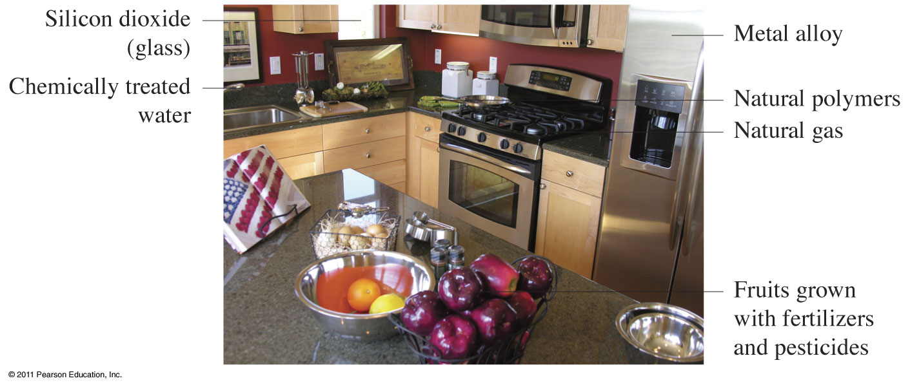
Chemicals
What are they??
There is nothing you can touch or hold that is not made of chemicals.

Slide 3
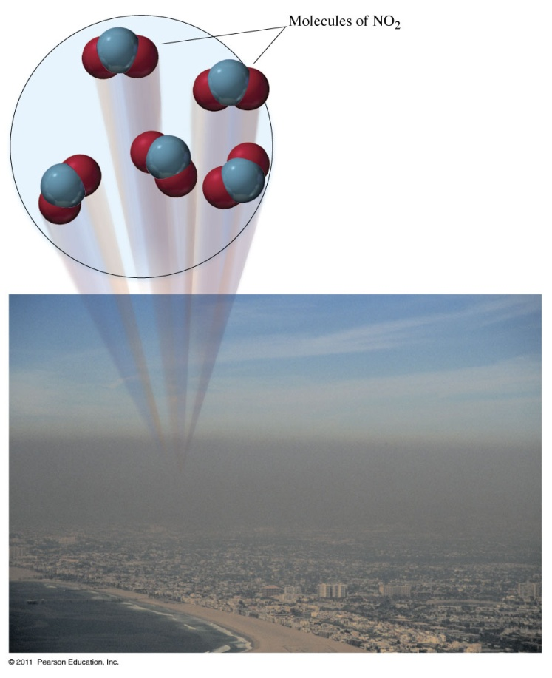
What is Chemistry?
Chemistry is the science of the properties, composition, and behavior of materials.
Chemistry is the science concerned with describing and explaining the different forms of matter and the chemical reactions of matter.

Slide 4
Branches of Chemistry
Applied Chemistry - the search for and isolation of useful materials.
Theoretical Chemistry - Provides a chemical view of nature and explanations of natural processes.
Organic Chemistry
Inorganic Chemistry
Biochemistry
Physical Chemistry

Slide 5
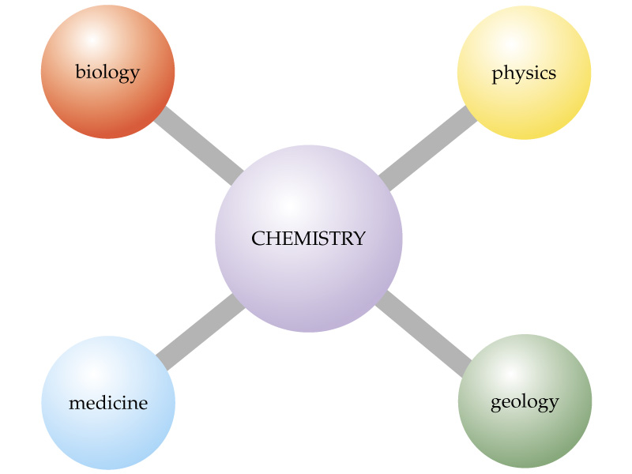
Chemistry is the Central Science

Slide 6
Thinking like a Chemist
What do you see?

Slide 7
Thinking like a Chemist
What does a chemist see?

Slide 8
Studying Chemistry
Be curious
Learn vocabulary (and nomenclature)
Keep current in the class. Don’t wait for a test
Form a study group
Do problems again and again!!

Slide 9
Scientific Method
Observation – a statement that accurately describes something we see, hear, taste, feel, or smell.
Conclusion – a statement that is based on what we think about a series of observations.

Slide 10
From Scientific Method
Empirical facts
(observations, data)
Scientific laws
(tested generalizations, consistent observations)
Hypothesis
(tentative explanation)
Theory or Models
(tested explanation, unifying explanation for a set of observations, facts and laws)

Slide 12
Matter
Matter
Anything that occupies space and has mass.
Mass
Measure of the amount of matter that an object contains. (unit – metric grams (g) )
Related to inertia – a tendency of a body at rest to be at rest
Weight
The effect of gravity on matter

Slide 13
States of Matter

Slide 14
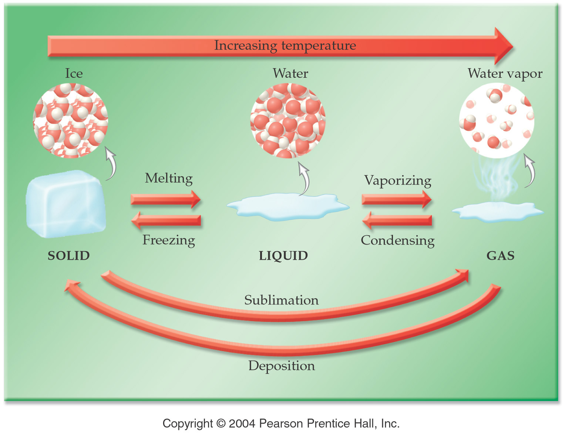

Slide 15
Classification of Matter

Slide 16
Properties of Al
Aluminum (Al) metal cannot be decomposed into simpler substances by chemical reactions.
Oxides of Al occur naturally in gem stones such as rubies and sapphires.
Al is alloyed with copper (Cu), magnesium (Mg), and other elements to form lightweight materials to be used in construction of aircraft and rockets.
Al ore (or bauxite) is electrolyzed to obtain metallic Al

Slide 17
Elements to know
http://www.periodictable.com/index.html

